Slide 1

Data Engineering Capstone Project
Ajay Varma

Slide 2
Business Problem / Context
Introduction:
• You have been hired as a new data engineer at Analytixlabs. Your first major task is a data engineering project on employees of the one of the big corporation from the 1980s and 1995s. All that remain of the database of employees from that period are six CSV files. In this project, you will design the tables to hold data in the CSVs, import the CSVs into a SQL database, import to HDFS/Hive, and perform analysis using Hive/Impala/Spark/SparkML using the data and create pipelines.
Project Description: In this project, you are required to create end to end data pipeline and analyzing the data.
Technology Stack: you are required to work on below technology Stack.
- MySQL (to create database)
- Linux Commands
- Sqoop (Transfer data from MySQL Server to HDFS/Hive)
- HDFS (to store the data) - Hive (to create database)
- Impala (to perform the EDA)
- SparkSQL (to perform the EDA)
- SparkML (to perform model building

Slide 3
About Data
The below dataset was provided by our client.
This data is about monthly sales data of various drugs in Diabetes Market.
The duration of the data is around 15 Years i.e. 1985-01-01 to 2000-01-28.
Data Engineering – Capstone Project Data: The entire employees data of various departments.
In Employees data set There are 3,00,025 records and 11 variables (emp_no, emp_title_id, birth_date, first_name, last_name, sex hire_date, no_of_projects, Last_performance_rating, left, last_date )
In Departments data set There are 10 records and 2 variables (dept_no, dept_name )
In dept_emp data set There are 331604 records and 2 variables (emp_no, dept_no )
In dept_manager data set There are 25 records and 11 variables (dept_no, emp_no )
In Salaries data set There are 3,00,025 records and 2 variables (emp_no, salary )
In titles data set There are 8 records and 2 variables (title_id, title )

Slide 4
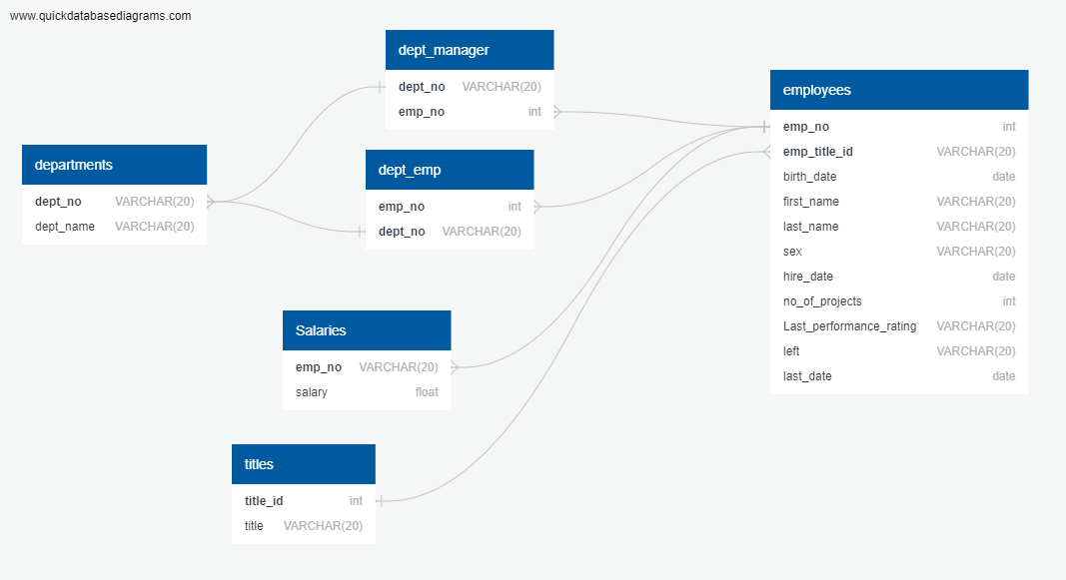
ERD

Slide 5
Analysis Used
Exploratory Data Analysis (EDA) / Descriptive Analytics
Salary Analysis
employees Frequency Analysis
department Analysis
designation Analysis
pipeline

Slide 6
Tools Used
Following tools are used to solve this business case.
For Analysis
MySql
Hive
Spark Sql
PySpark
sqoop
For Documentation & Presentation
Microsoft Power Point

Slide 7
Overall Analysis
Total Employee’s
300025
Total Departments
10
Total Designation
8
Total duration
(1985-01-01 to 2000-01-28)

Slide 8
Pipe line
SQOOP
MySql Server
HDFS
Hive & Impala
Spark
In HDFS
Data is loaded in form of Avro and Parquet file formats
Performed
Data analysis in Hive and Impala
Performed analysis using SparkSql and SparkML
Imported the Raw files from local and loaded into MySql Server
Using Sqoop extracted the data from MySql server and loaded into HDFS

Slide 9
MySql Server
Created departments, dept_emp, dept_manager, employees, salaries and tables in MySql Server and loaded the data. Initially created Sami-pipeline file as shown below
File.Sql
CREATE TABLE departments (dept_no VARCHAR(20),dept_name VARCHAR(20));
CREATE TABLE dept_emp (emp_no VARCHAR(20),dept_no VARCHAR(20));
CREATE TABLE dept_manager (dept_no VARCHAR(20), emp_no VARCHAR(20));
CREATE TABLE employees (emp_no VARCHAR(20),emp_title_id VARCHAR(20),birth_date VARCHAR(20),first_name VARCHAR(20),last_name VARCHAR(20),sex VARCHAR(20),hire_date VARCHAR(20),no_of_projects VARCHAR(20),Last_performance_rating VARCHAR(20),left_ VARCHAR(20),last_date VARCHAR(20));
CREATE TABLE salaries (emp_no VARCHAR(20),salary VARCHAR(20));
CREATE TABLE titles (title_id VARCHAR(20),title VARCHAR(20));
LOAD DATA LOCAL INFILE '/home/anabig114249/Data_final/departments.csv' INTO TABLE departments FIELDS TERMINATED BY ',' LINES TERMINATED BY '\n' ignore 1 rows;
LOAD DATA LOCAL INFILE '/home/anabig114249/Data_final/dept_emp.csv' INTO TABLE dept_emp FIELDS TERMINATED BY ',' LINES TERMINATED BY '\n' ignore 1 rows;
LOAD DATA LOCAL INFILE '/home/anabig114249/Data_final/dept_manager.csv' INTO TABLE dept_manager FIELDS TERMINATED BY ',' LINES TERMINATED BY '\n' ignore 1 rows;
LOAD DATA LOCAL INFILE '/home/anabig114249/Data_final/employees.csv' INTO TABLE employees FIELDS TERMINATED BY ',' LINES TERMINATED BY '\n' ignore 1 rows;
LOAD DATA LOCAL INFILE '/home/anabig114249/Data_final/salaries.csv' INTO TABLE salaries FIELDS TERMINATED BY ',' LINES TERMINATED BY '\n' ignore 1 rows;
LOAD DATA LOCAL INFILE '/home/anabig114249/Data_final/titles.csv' INTO TABLE titles FIELDS TERMINATED BY ',' LINES TERMINATED BY '\n' ignore 1 rows;

Slide 10
SQOOP
Using Sqoop extracted the file from MySql server and converted into Avro or Parquet then loaded into HDFS. Also created pipeline as Sqoop.sq
SQOOP.sh
*dislay the list of databases in mysql
sqoop list-databases --connect jdbc:mysql://ip-10-1-1-204.ap-south-1.compute.internal:3306 --username anabig114249 --password Bigdata123
#**dislay the list of tables in the databases in mysql
sqoop list-tables --connect jdbc:mysql://ip-10-1-1-204.ap-south-1.compute.internal:3306/anabig114249 --username anabig114249 --password Bigdata123
#** to import all tables into hdfs avrodatafile format using sqoop
sqoop import-all-tables --connect jdbc:mysql://ip-10-1-1-204.ap-south-1.compute.internal:3306/anabig114249 --username anabig114249 --password Bigdata123 --compression-codec=snappy --as-avrodatafile --warehouse-dir=/user/anabig114249/hive/warehouse --driver com.mysql.jdbc.Driver --m 1
#** to import all tables into hdfs parquetfile format using sqoop
sqoop import-all-tables --connect jdbc:mysql://ip-10-1-1-204.ap-south-1.compute.internal:3306/anabig114249 --username anabig114249 --password Bigdata123 --compression-codec=snappy --as-parquetfile --warehouse-dir=/user/anabig114249/hive/warehouse2 --driver com.mysql.jdbc.Driver --m 1
#sqoop import --connect jdbc:mysql://ip-10-1-1-204.ap-south-1.compute.internal:3306/anabig114249 --username anabig114249 --password Bigdata123 --driver com.mysql.jdbc.Driver --table dept_emp --target-dir =/user/anabig114249/hive/warehouse
#**to check data is imported to hdfs
hdfs dfs -ls /user/anabig114249/hive/warehouse
#**to check schema is imported to local
ls -l *.avsc

Slide 11
Analysis using Hive

Slide 12
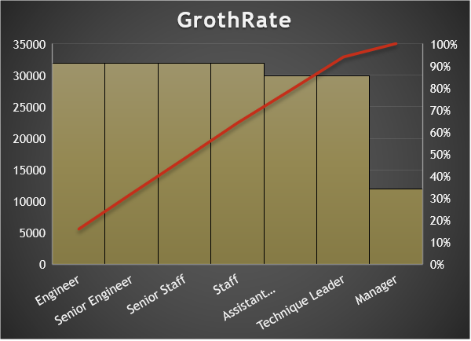
Grothrate based on salary, time and designation

Slide 13
Analysis based on performance

Slide 14
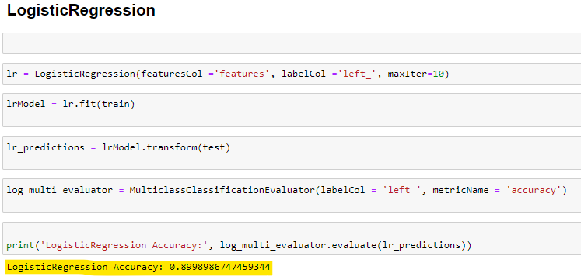
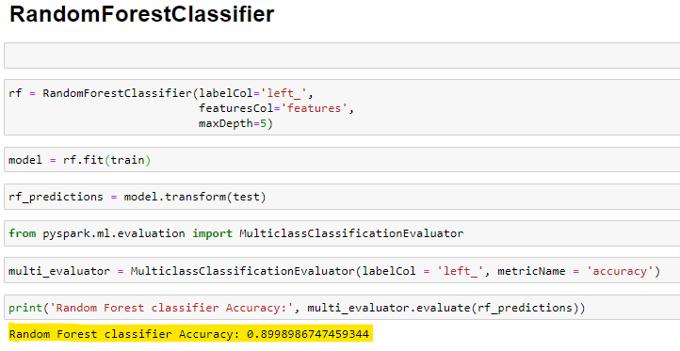
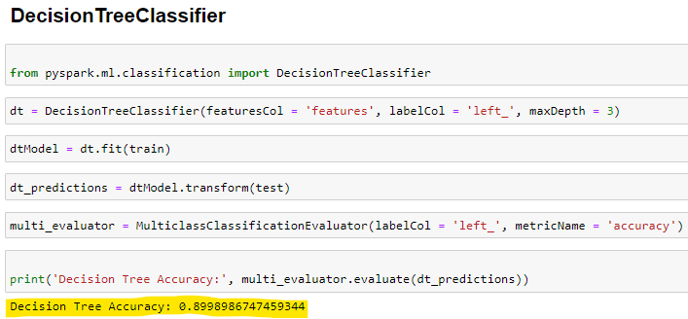
Built classification model by using algorithms like logistic regression and random forest and decision tree classifier in spark ML By considering Target variable as left and other variables as independent variables
Acquired around 90% Accuracy

Slide 15


